Slide 1

Team Name : ELYSIANS
Project Name : CLASSWORK
College : Bannari Amman Institute of Technology
Team Members : AKASHPRABU A C
HEMANG MURUGAN
ASWINI K

Slide 2
Problem Statement
We are living amidst what is potentially one of the greatest threats in our lifetime to global education, a gigantic educational crisis as well as a huge economic loss. At these times most of the students and job workers are lacking certain academic work and training. Even though there are a lot of E Learning platforms available on the internet. Students and Professionals find it difficult to perform their daily routine like file sharing, online classes and training, Viewing their timetables and Schedules, asking doubts and discussions, practising sessions and their coding skills, as far as students are concerned they need to take their tests to keep in check with their academic work, this test platform should be proctored in faculty perspective. so the point is that there are several platforms for doing the works mentioned above. But most of the students will find it difficult to work on multiple platforms and keep their progress in check. At some point few students might face network issues in that case they cannot access their study materials. And a Virtual Environment which focuses on the white board and avoids the disturbances during Online classes. So there is a need for a platform to be made where all these features are integrated in a single application.

Slide 3
Proposed Solution
CLASSWORK plays a major role in integrating these features into a single application. This platform is safe, secure and authorized to use by any Organisation or Educational Institutions. It has a smooth User Interface and Easily understandable to work. The Faculty/Team leader of a project can update the changes for the students/Employees to keep them on track by having a different UI. At this pandemic time most of the students have to adapt to the changes which are required by the E-Learning applications such as Operating Systems, but CLASSWORK is a cross platform compatible application. CLASSWORK is an inexpensive, efficient and comfortable way for students to easily access their notes and study for exams. With this project we no need to depend on multiple platforms for accessing learning materials, attending virtual classes which has attendance system in it. On the faculty’s perspective most of the students are not focusing the classes, so here we have implement an image processing method to monitor/detect the movements of the student during the classes an alert message will be sent to faculty if there is the student is not concentrating. It also has Notes sharing, Proctored Test platform, Online compiler for practice, Forums for Discussions, Dynamic Time Table and SMS notes sharing Features.The metrics of the application such as uploading rate, downloading rate, time taken to search for file, time taken for authentication, time taken for sign up have been measured and checked to ensure good performance.

Slide 4




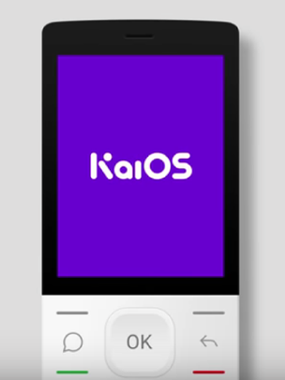

Proposed TechStack
HTML
MySQL
Image Processing
CSS
JAVASCRIPT
PHP
NODE.JS
NODE.JS
FRONTEND
BACKEND
Socket io
Webrtc

Slide 5
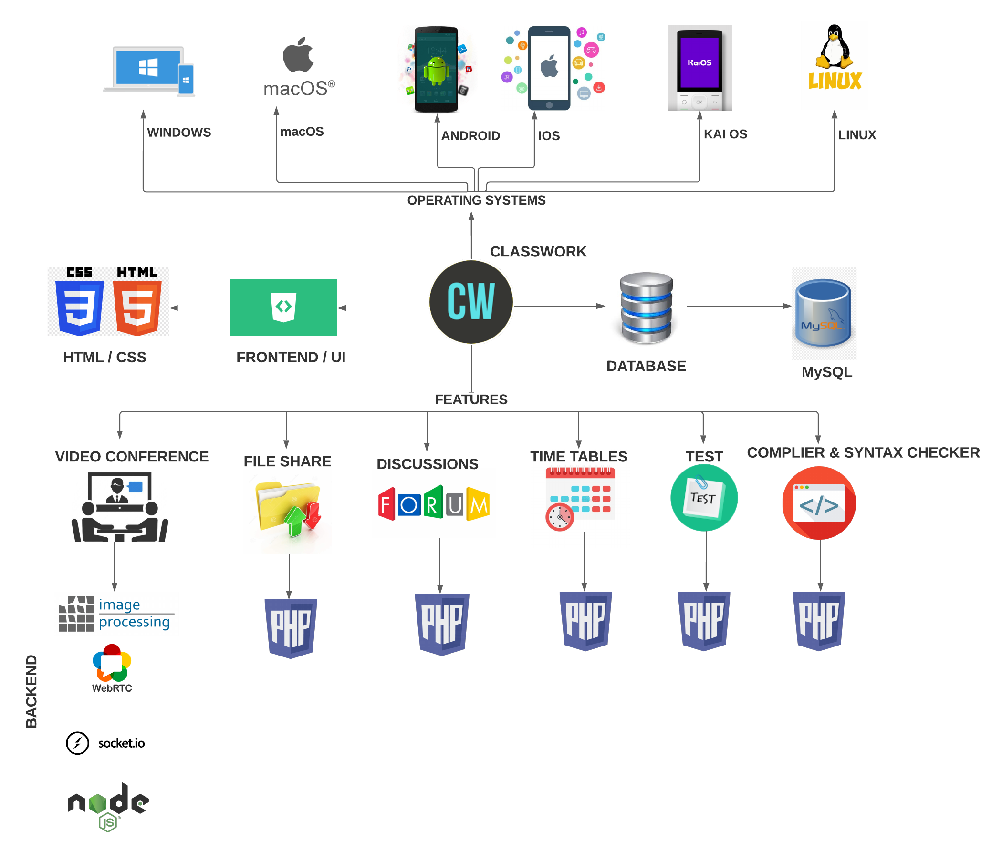
Methodology
SYSTEM STRUCTURE

Slide 6
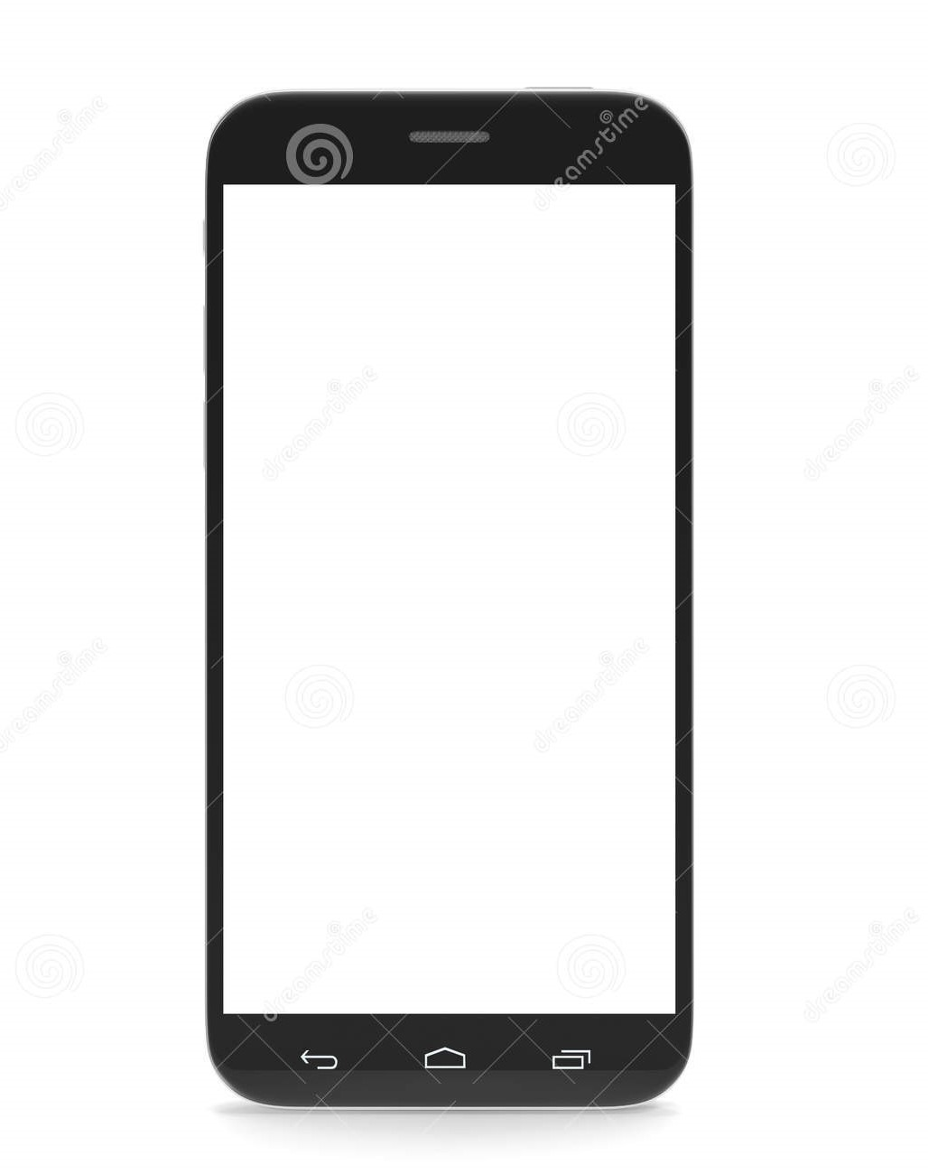














Block Diagram ( Workflow )
FEATURES
BACKEND
VIDEO CONFERENCE
FILES AND STUDY MATERIALS
SMARTPHONES
CLASSWORK
( WEB APP)
USER
OPERATING SYSTEMS
TIME TABLE
DISCUSSIONS
COMPILER & SYNTAX CHECKER

Slide 7
Advantages over the existing solution
CLASSWORK is a single platform where all the academic works like posting materials, accessing those materials, knowing their time table, practise sessions, groups & discussions, test platforms and attending online virtual classes are implemented on a single platform.
Assessment and practice sessions features are implemented in the application.
CLASSWORK has an image processing method to monitor/detect the students if they are not focusing on the class with an immediate alert message sent to the faculty
It also has the sharing notes through SMS feature. Incase if the student is not having any social media.
Cross Platform compatible.

Slide 8
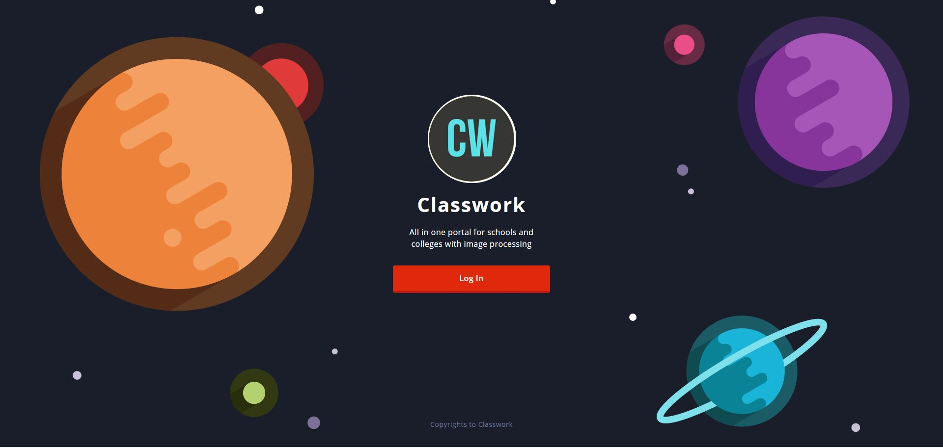

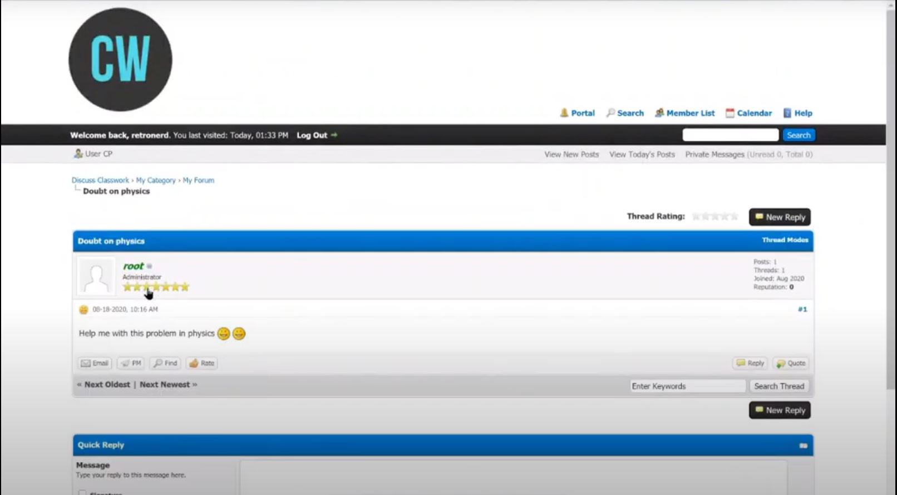
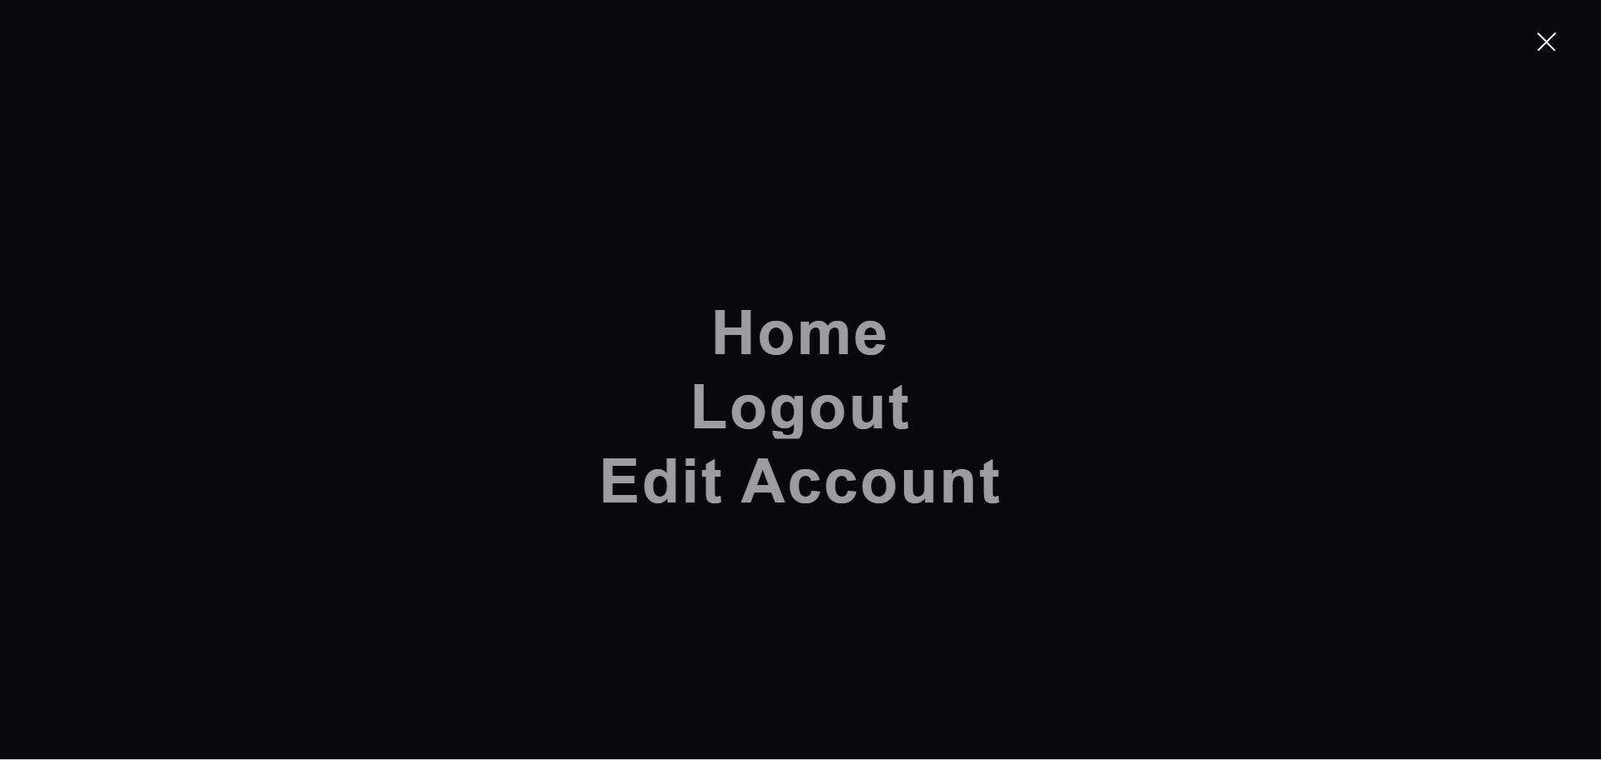
Prototype Images

Slide 9
THANK YOU!

